Slide 1

The Key Kap

Slide 2




Slide 3






Slide 4



Slide 5
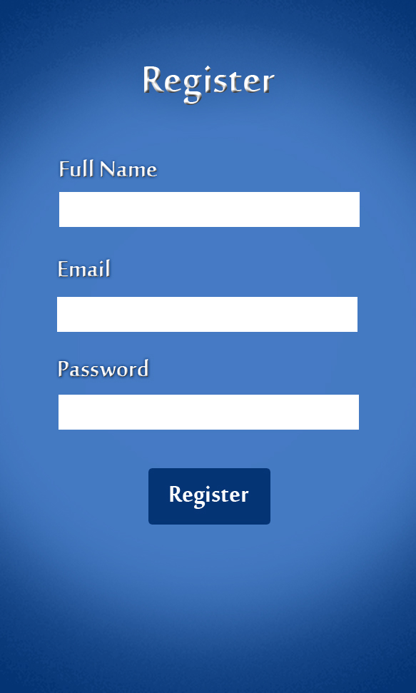

Slide 6
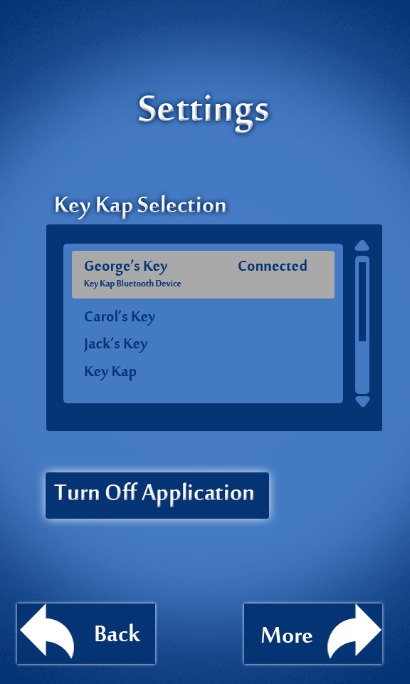




Slide 7


Slide 8
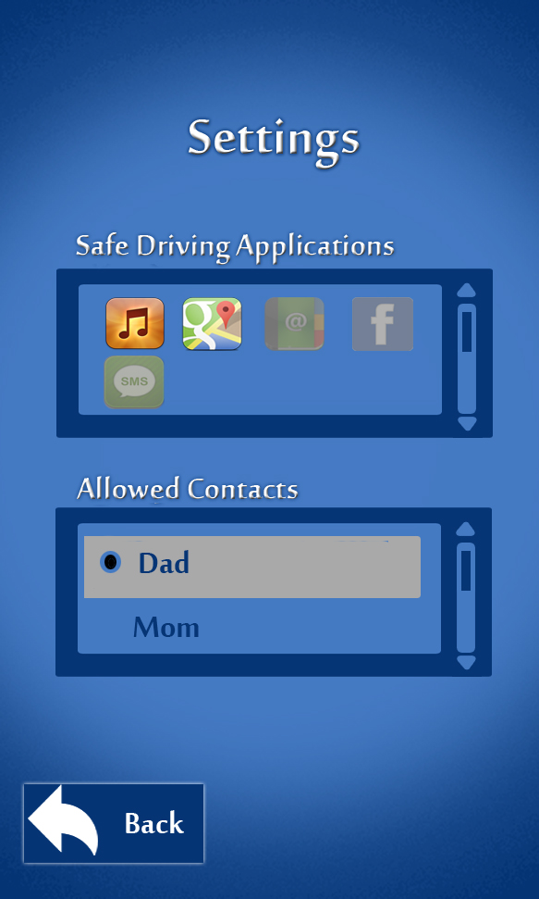

Slide 9
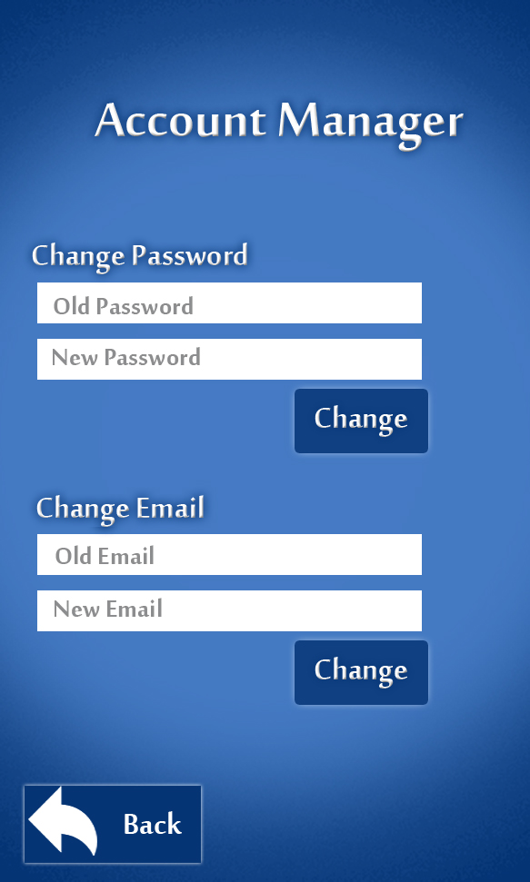

Slide 10
